Slide 1

A Project by
Jaiprakash Chandraker
Student No 22213546 Prajna Paramita Panda Student No 22214453

Slide 2

Temporal Dynamics of Stock Prices: A Comparative Analysis

Slide 3

Introduction
Financial markets play a crucial role in our global economy. The success of an investor depends on quality information and timely decision-making. This analysis focuses on how Adani and Reliance, as significant players in the Indian stock market, perform in this ever-changing landscape.
This Analysis involves a thorough examination using various methodologies, such as trend analysis, seasonality identification, and advanced statistical techniques like Seasonal Decomposition of Time Series. We aim to provide insights into the unique growth patterns and trajectories of these stocks.

Slide 4

Research Question and Methodology
The research question revolves around comparing and analyzing the performance of Adani and Reliance stocks over overlapping periods. We're using a sophisticated approach, employing the Seasonal Decomposition of Time Series and visualizations like line charts and candlestick charts.

Slide 5
About Datasets
Datasets Overview
Let's start by understanding data. This analysis has two datasets - one for Adani Ports covering 2007 to 2021 and another for Reliance Industries spanning 2005 to 2023. These datasets provide a comprehensive view of daily stock market activities.

Slide 6
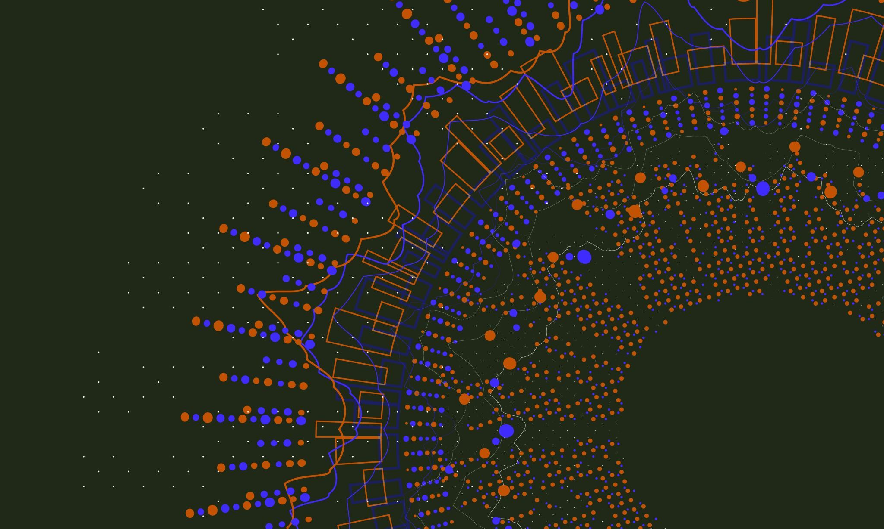
Potential Insights
The datasets can reveal trends, patterns, and correlations in stock prices and trading volumes over specific time periods. In this analysis, will explore these insights and draw comparisons between Adani and Reliance.

Slide 7
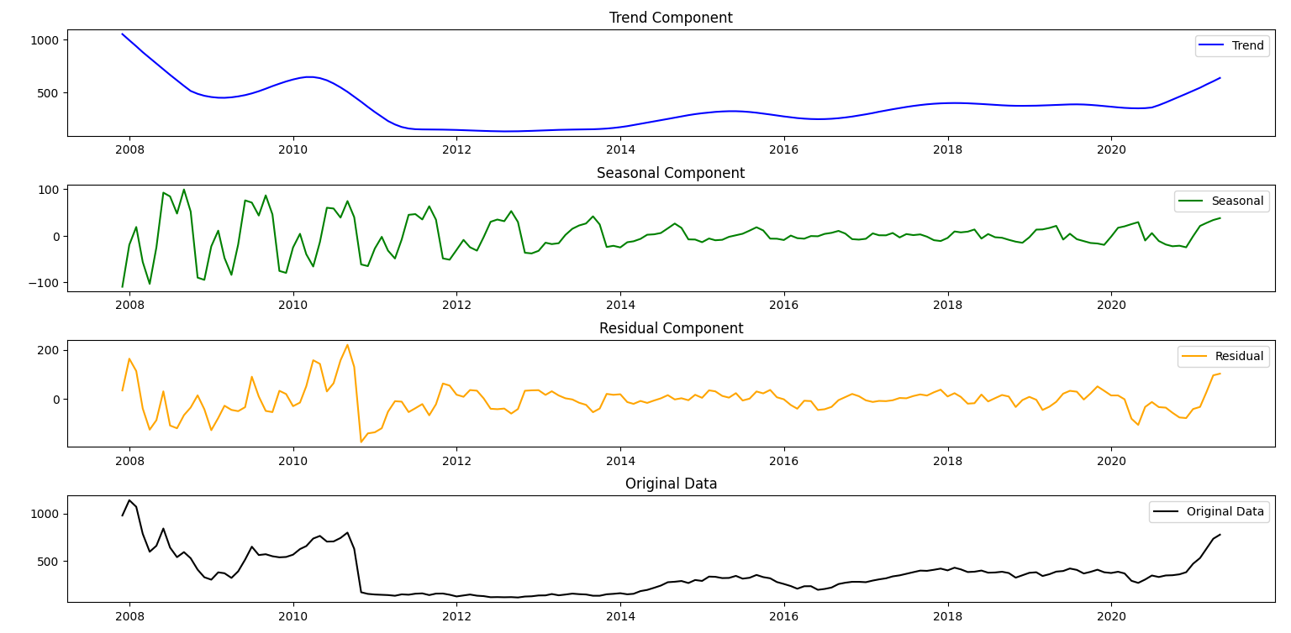
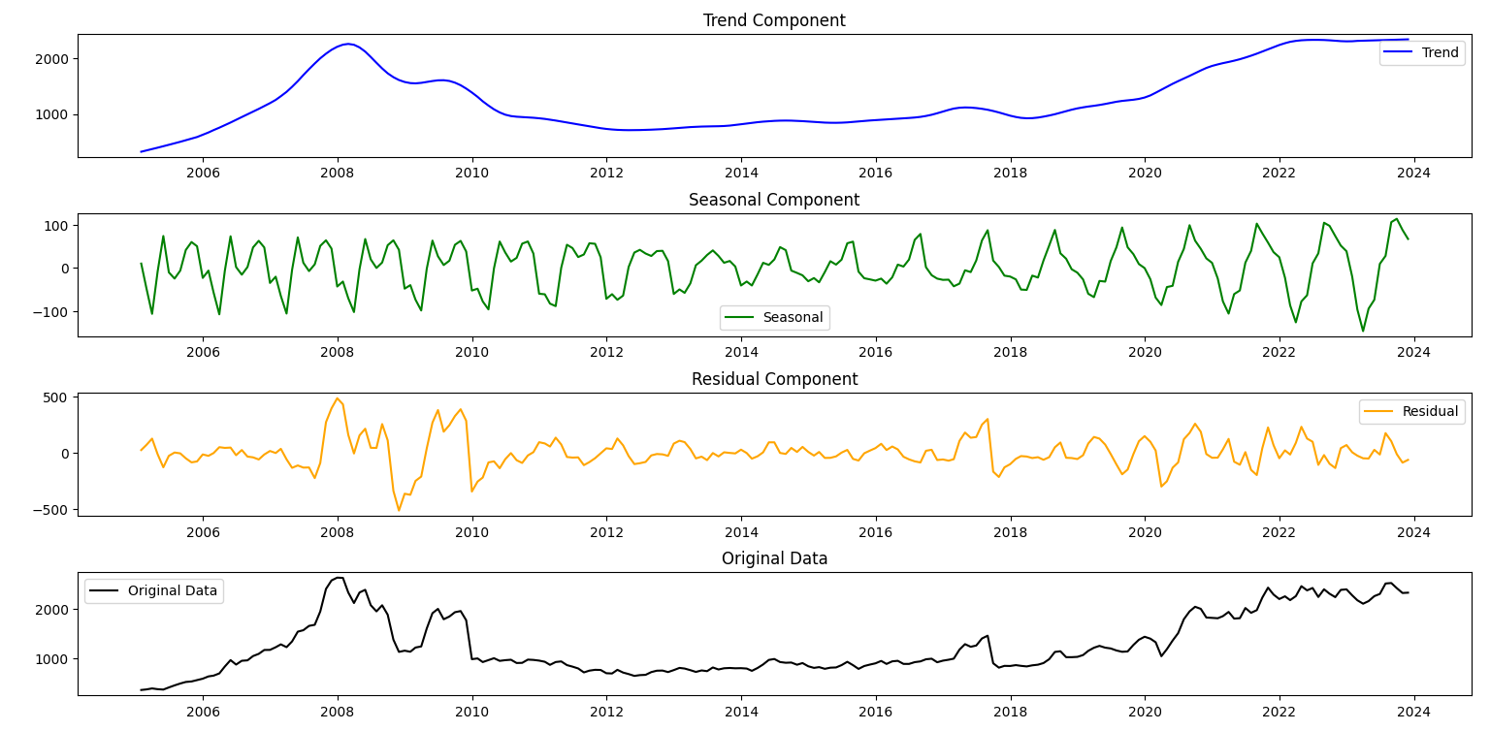
Comparative Analysis
Comparative Analysis of Time Series Decomposition
The decomposition of time series data for Adani and Reliance. The breakdown into trend, seasonal, and residual components provides valuable insights into the historical performance of these stocks.

Slide 8
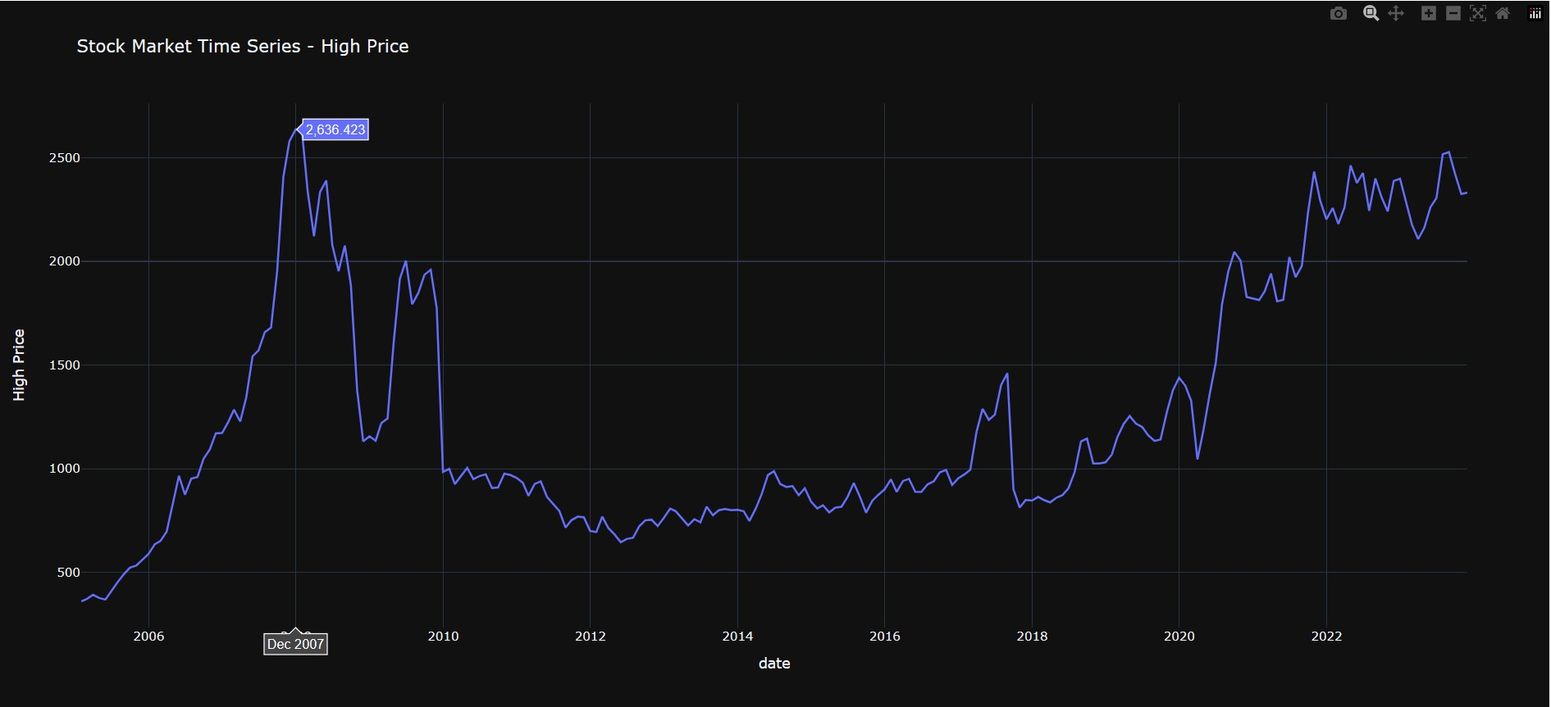
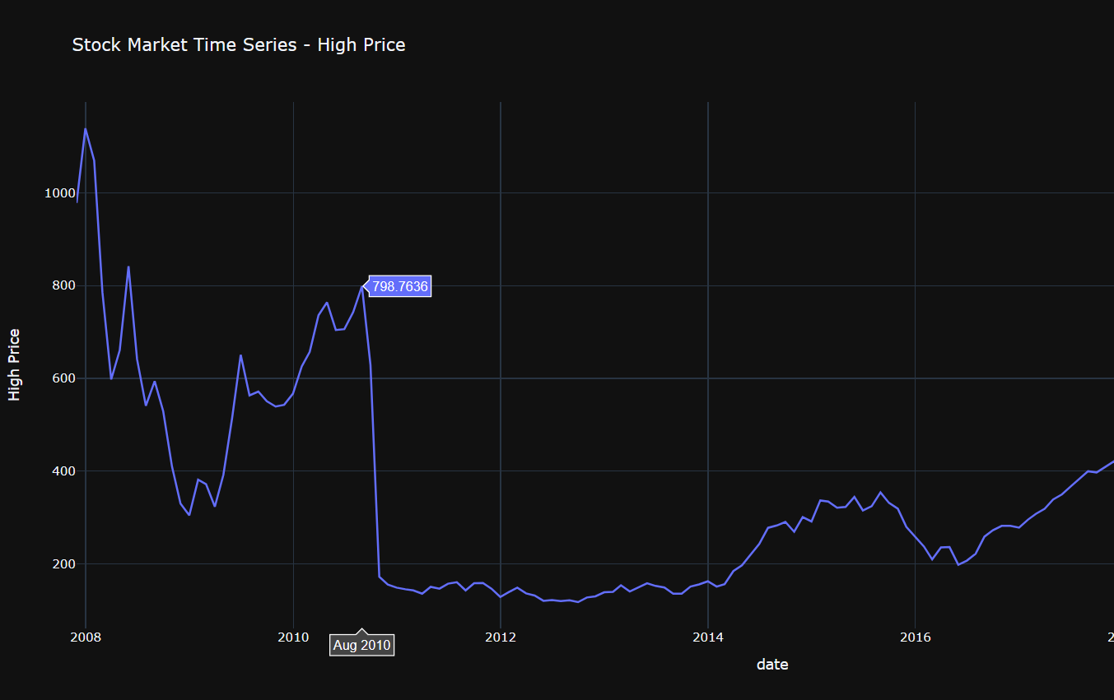
Comparative Analysis
Comparative Analysis of Line Chart - High Prices
Both Adani and Reliance exhibit periods of stability, downturns, and subsequent recoveries. Adani experienced a notable surge around 2020, while Reliance showed consistent growth after 2016. Investors should consider these patterns when making investment decisions, taking into account the historical performance and potential future trends of these stocks.

Slide 9
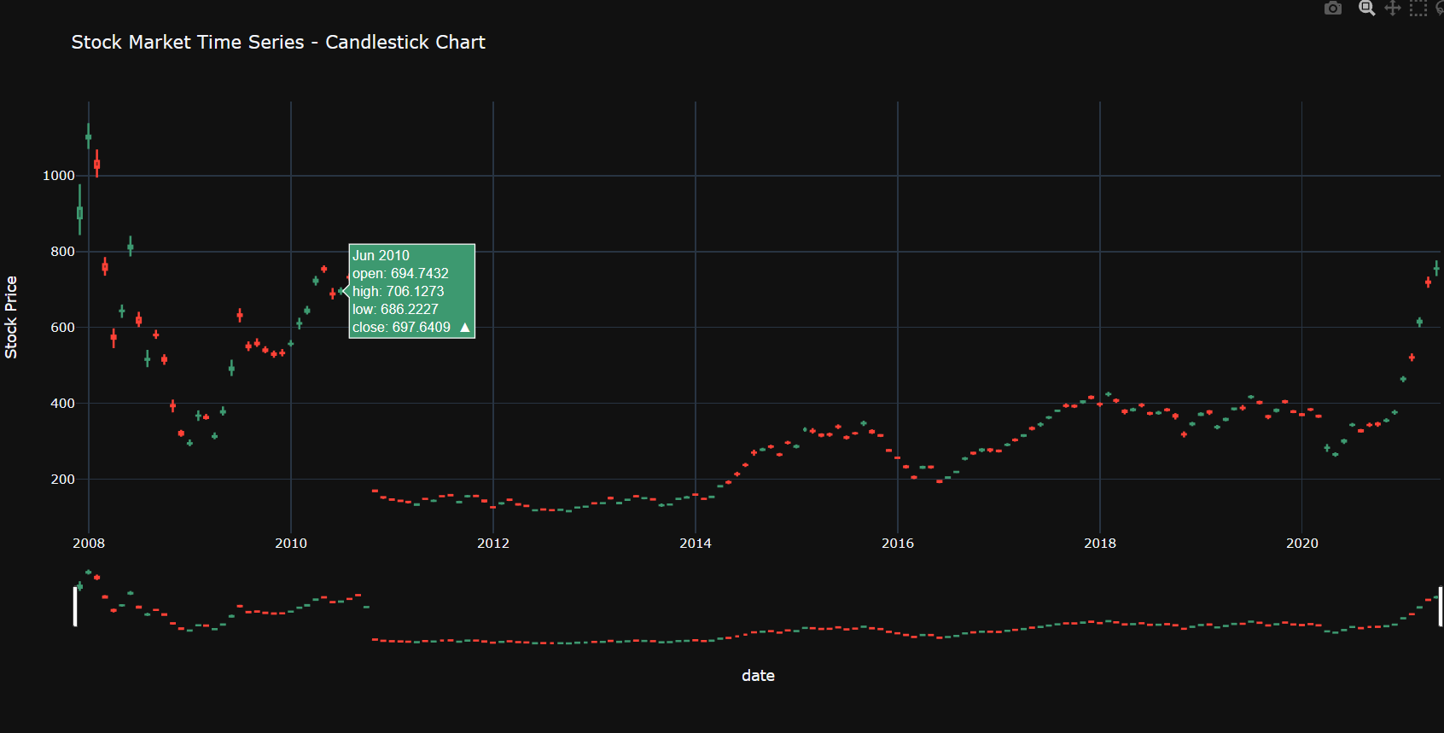
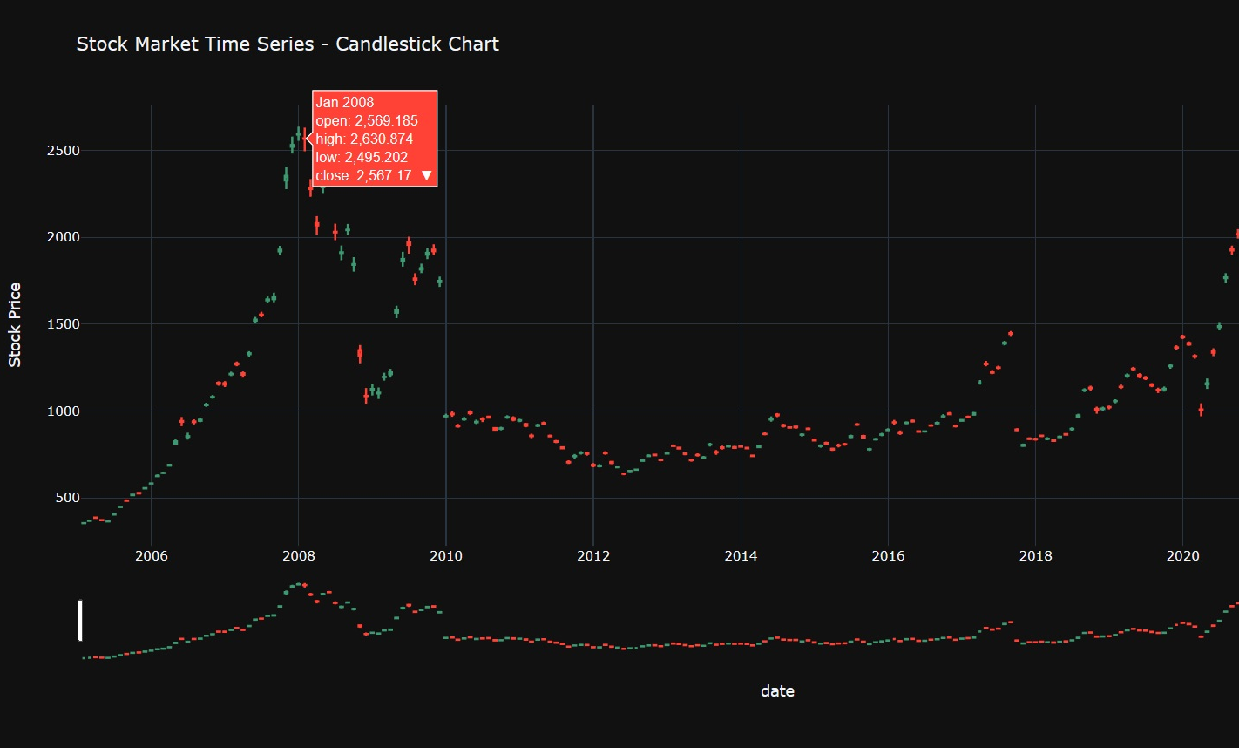
Comparative Analysis
Comparative Analysis of Candlestick Chart
Both Adani and Reliance exhibit distinctive patterns in their candlestick charts. While Reliance demonstrates a growth phase with sustained stability, Adani showcases a recovery period post-2008 and a notable upsurge in recent years. Investors should consider these trends and historical performances when making investment decisions, aligning their strategies with the unique characteristics of each stock.

Slide 10

Conclusion
In conclusion, This analysis offers a detailed examination of the temporal dynamics of stock prices for Adani Ports and Reliance Industries. We've uncovered unique insights into their performance, aiding investors and decision-makers.

Slide 11

Thank You
Thank you for your attention. If you have any questions or would like more details, feel free to ask. This analysis goal is to contribute to the conversation on investing strategies and provide practical insights for navigating the stock market.

